Slide 1






Paper 46
Data augmentation for breast mass segmentation
Luc Caselles
Clément Jailin
Serge Muller
Supporting Academic Organization
Media Partner

Slide 2
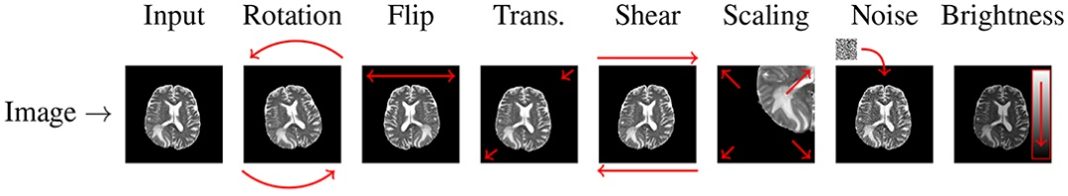
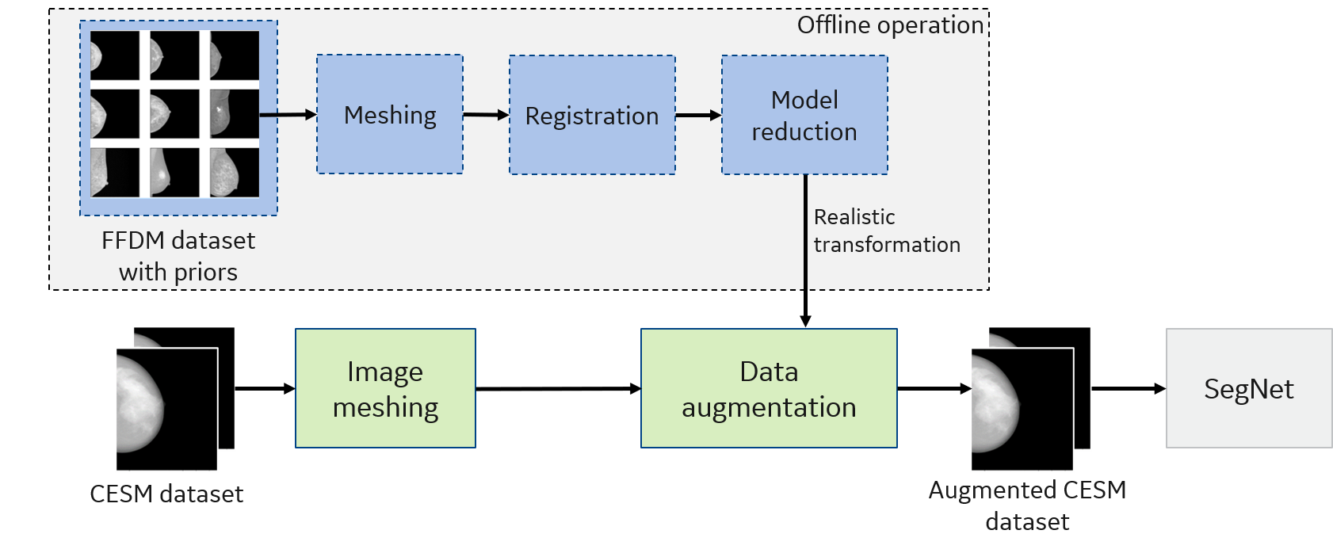
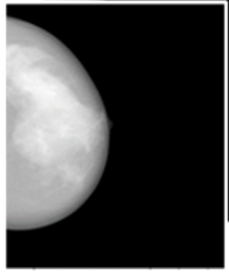
Data augmentation
Data augmentation ?
Increase the amount of data by adding slightly modified copies of existing data or by creating synthetic data from existing data
Classical data augmentation:
Geometrical transforms (rigid body motions, affine transforms, elastic deformations, etc.), flips, etc.
Intensity modification (global brightness/contrast changes, color jittering), Noise addition, etc.
Add limited variability to the training dataset and introduce unrealistic patterns
Mammography images
Augmented mammography images

Slide 3
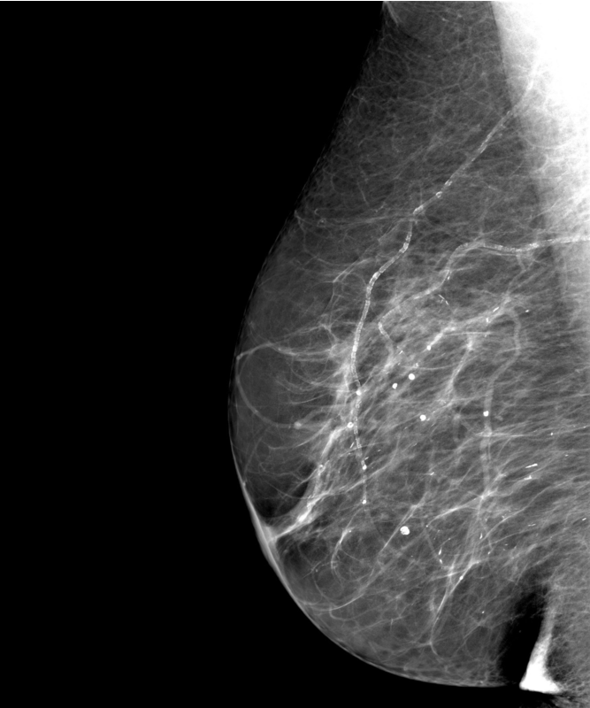
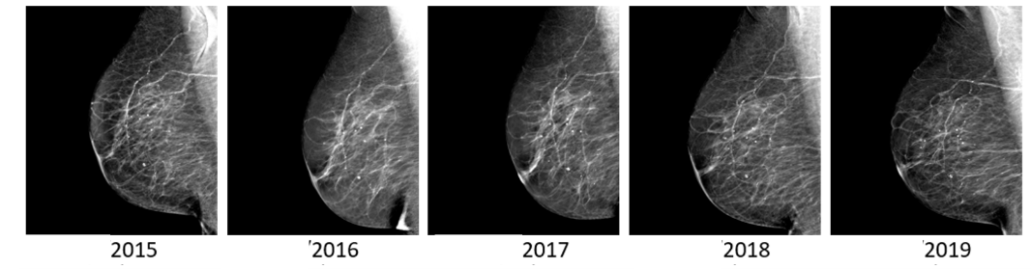
Introduction of the proposed data augmentation
If a patient were to take multiple exams in the same day, the intensity variations in images are due to:
Changes in breast position – geometry transforms
Intensity variations due to a change in acquisition parameters – intensity transforms
Those variations should not modify the diagnostic
→ We want to make our model invariant to those transforms
Leverage the full screening history of patients to generate realistic fields
Multiple acquisitions of the same patient
Design of a realistic transformation model

Slide 4
Design of breast transformation models

Slide 5
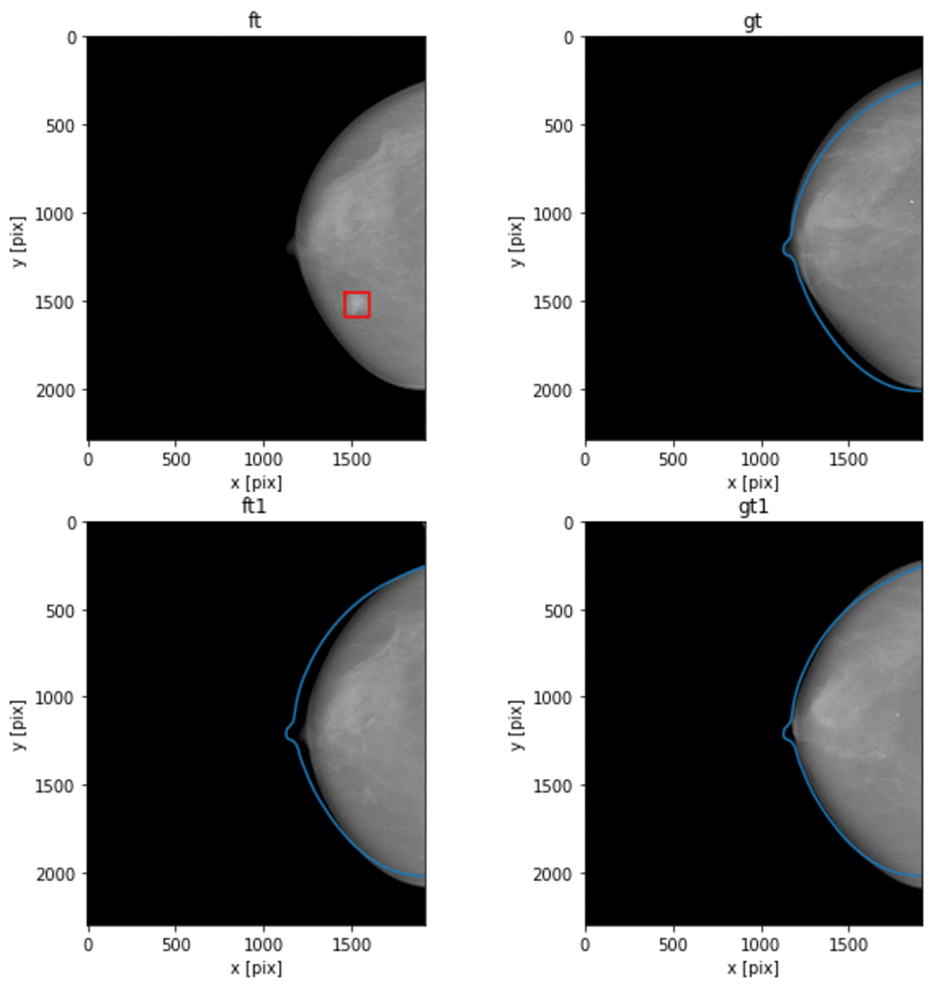
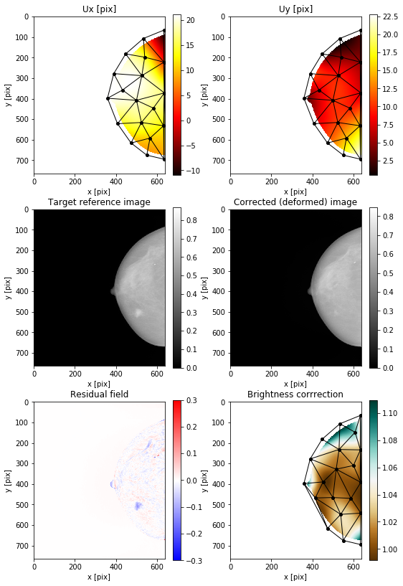
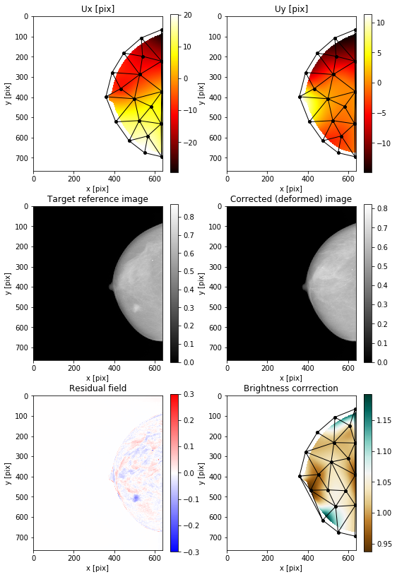
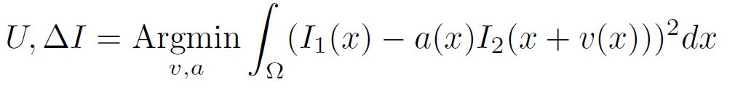
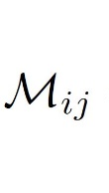
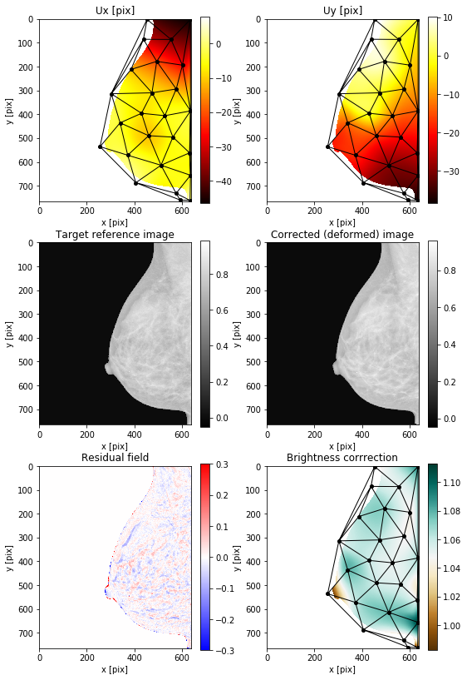
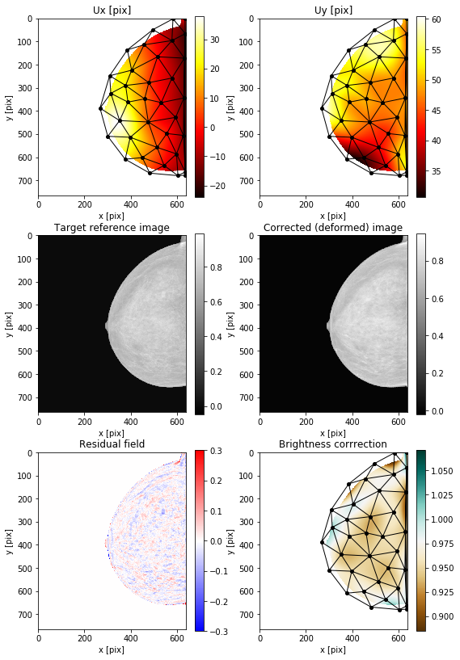
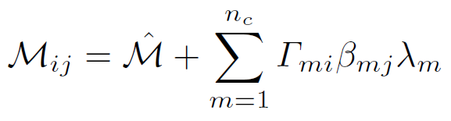
Registration procedure
Measured kinematics
Intensity correction
Real geometrical transforms and intensity transforms measured on 583 patients with priors
→ 583 MLO and CC transformation fields are extracted
PCA reduction
Reduced transformation model
Eigenvalue
Space component
Mean field
Patient component

Slide 6
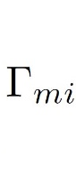
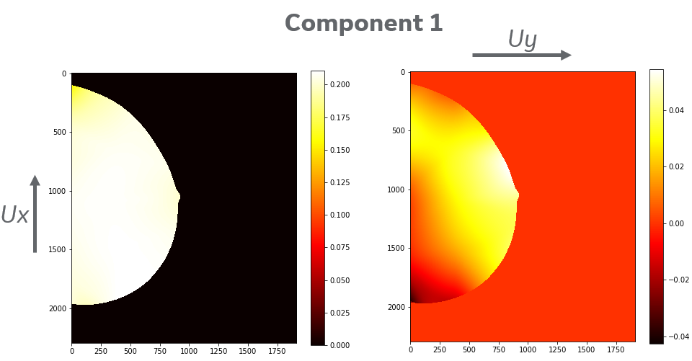
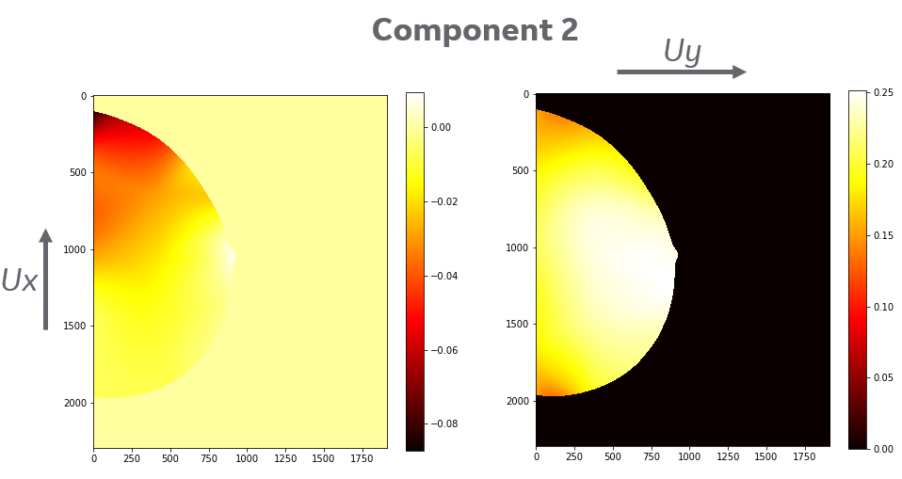
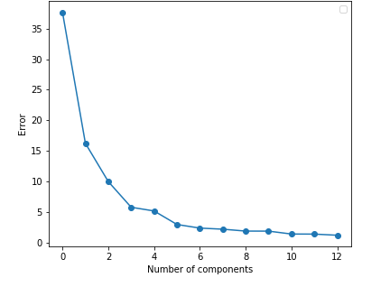
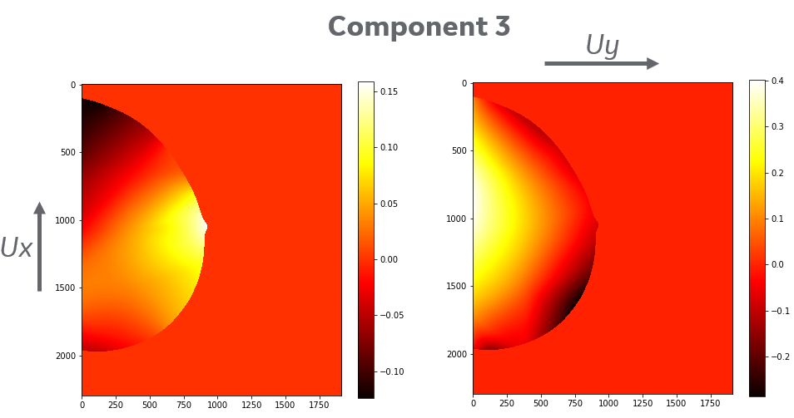
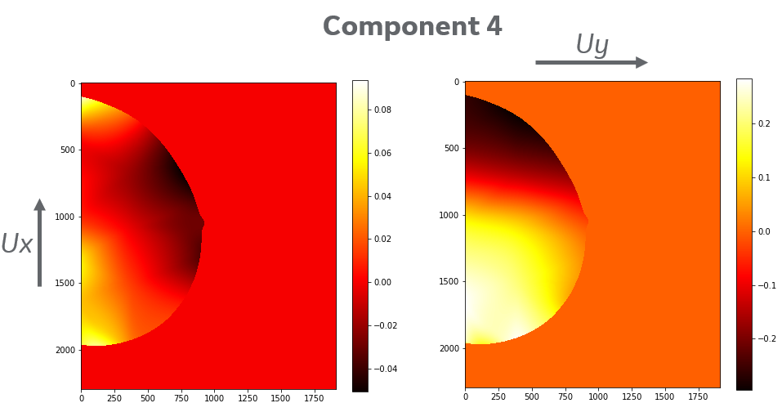
Reduced transformation model
Example of the first CC spatial modes
Chosen truncation
24 dimensions
The complete space is composed of 24 dimensions,
→ n_{c} = 6 components are selected for the reduced model
Note that similar method is applied on MLO results

Slide 7
Reduced transformation model
Example of the first CC spatial modes
Zoom like mode
Chosen truncation
24 dimensions
The complete space is composed of 24 dimensions,
→ n_{c} = 6 components are selected for the reduced model
Rotation like mode
Note that similar method is applied on MLO results

Slide 8
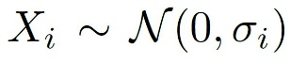
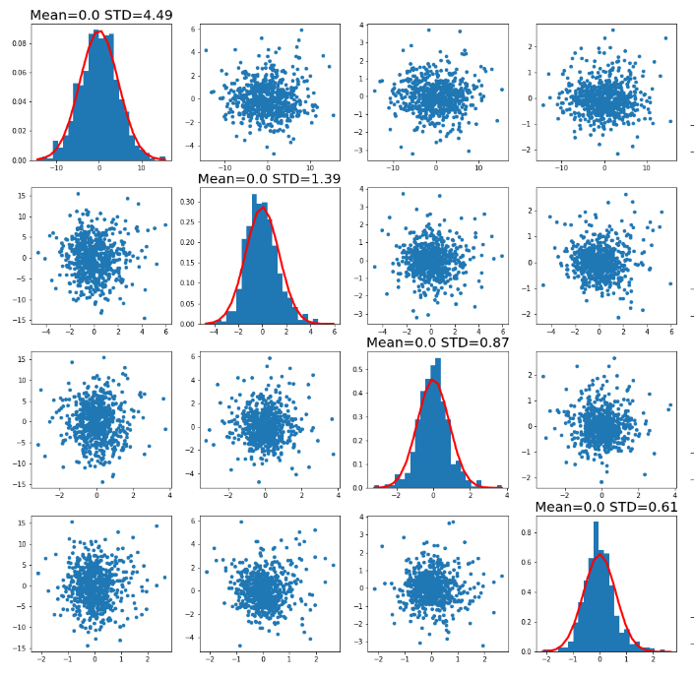
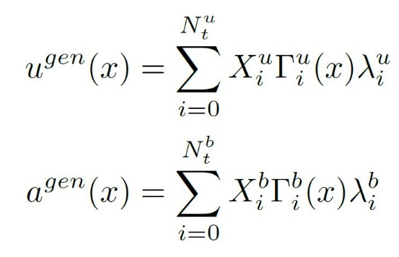

Reduced transformation model
Normal distribution is fitted by maximizing likelihood with projections distribution
No nonlinear correlations between modes
The random transforms are generated as following:
Example of the first CC patient component
$$β_{mj}.β_{ni}$$
n=1
n=2
n=3
n=4
m=1
m=2
Displacement:
m=3
Local intensity transforms:
m=4

Slide 9
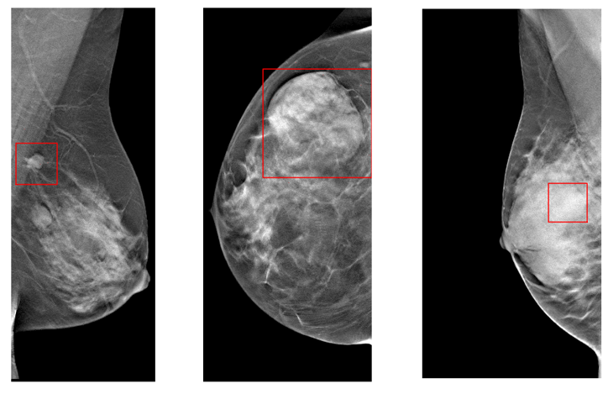
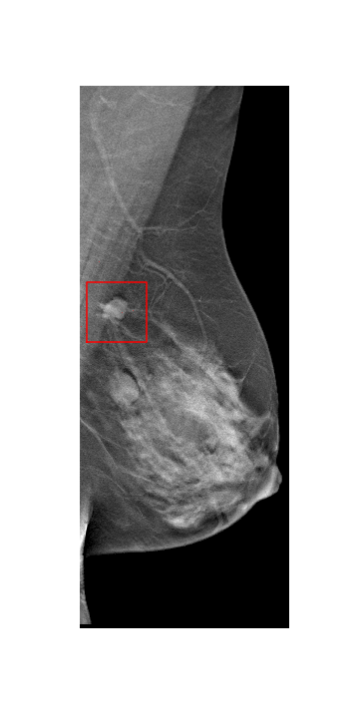
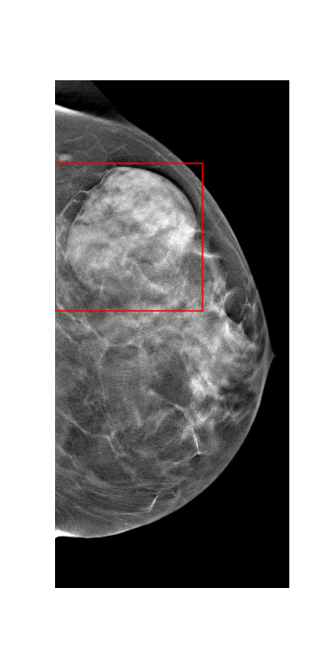
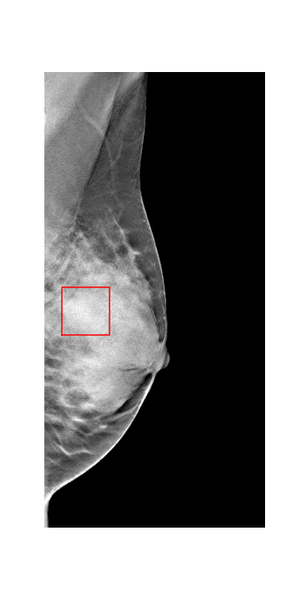


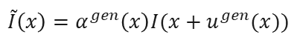
Examples of augmentation
Single exam with lesion:
$$I(x)$$
Example of transformations applied on one patient
Design of a physical model to capture and generate those intensity variations
$$\tilde{I}\left(x\right)=α^{gen}\left(x\right)I(x+u^{gen}(x))$$
Multiple virtual exams acquisition
Augmented images:
$$\tilde{I}\left(x\right)$$

Slide 10
Data augmentation for segmentation

Slide 11
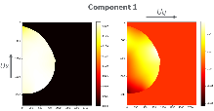

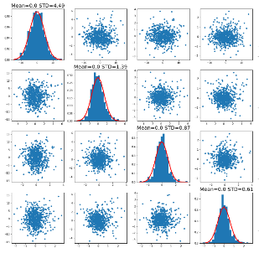
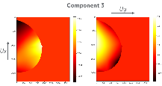
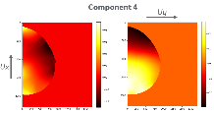
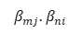
Transfer of the variability learned in the mammography dataset
The goal is now to transfer the extracted variability from the large mammography database to a small CESM database
$$β_{mj}.β_{ni}$$
n=1
n=2
n=3
n=4
m=1
m=2
m=3
m=4
CESM database:
204 CESM exams with segmented lesion in CC and MLO
Intensity transforms applied on low energy images

Slide 12
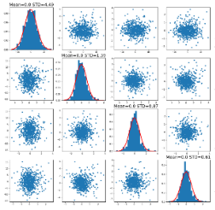
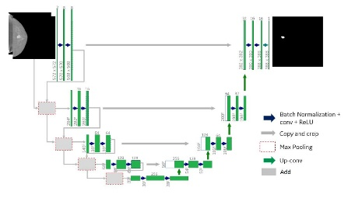
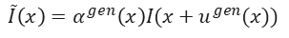
Transfer of the variability learned in the mammography dataset
The goal is now to transfer the extracted variability from the large mammography database to a small CESM database
$$β_{mj}.β_{ni}$$
n=1
n=2
n=3
n=4
m=1
m=2
m=3
m=4
Unet-ResNet
Segmentation network
$$\tilde{I}\left(x\right)=α^{gen}\left(x\right)I(x+u^{gen}(x))$$
CESM database:
204 CESM exams with segmented lesion in CC and MLO
Intensity transforms applied on low energy images

Slide 13
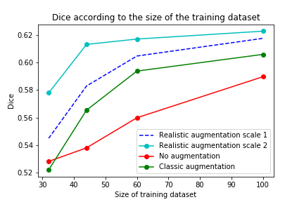
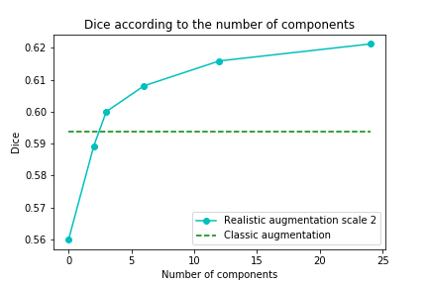
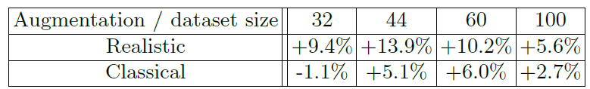
Results – data augmentation methods
Dataset composed of
Validation / test dataset: 50 / 48 screenings
Same validation and test dataset for all tests
→ Improvement with both metrics with the proposed approach
32 images with augmentation is equivalent to 100 images without.
The variability transfer may be tuned by the amplitude coefficient.
Strong correlation of data augmentation efficiency with the problem complexity
* Classical augmentation: Rotation, translation, shear, histogram equalization

Slide 14
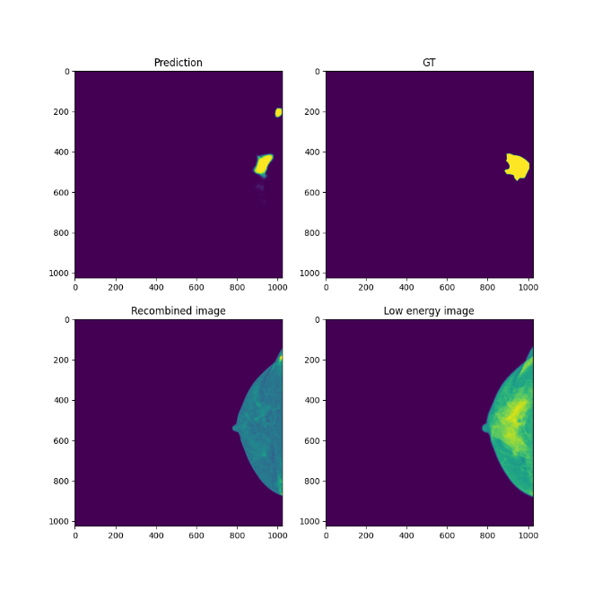
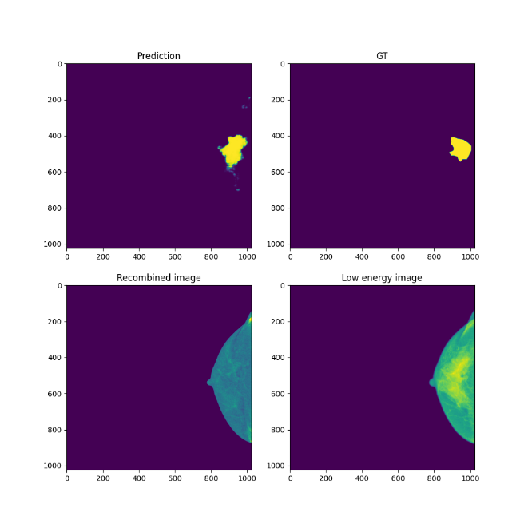

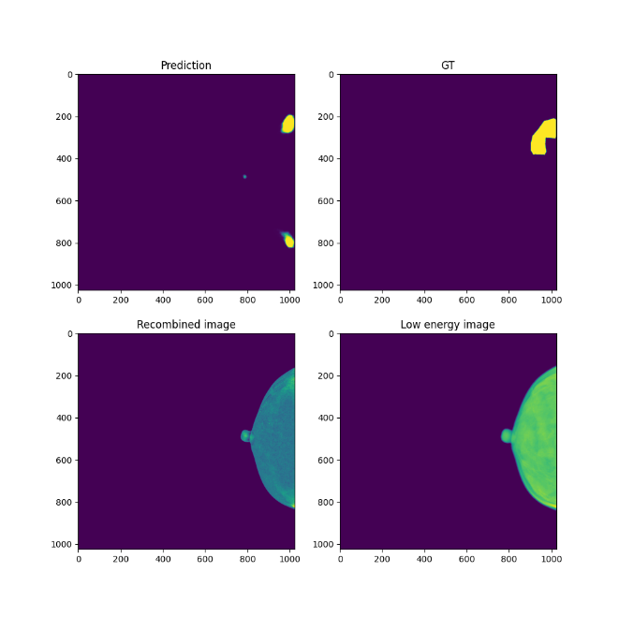
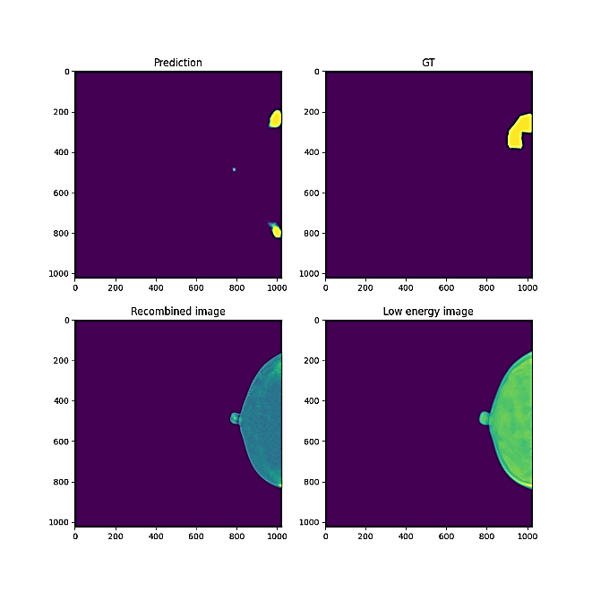
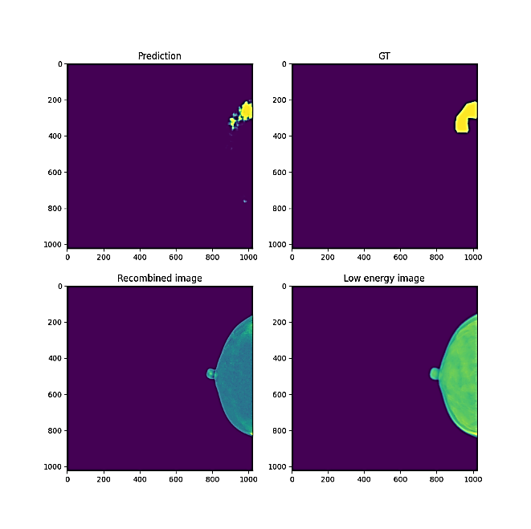
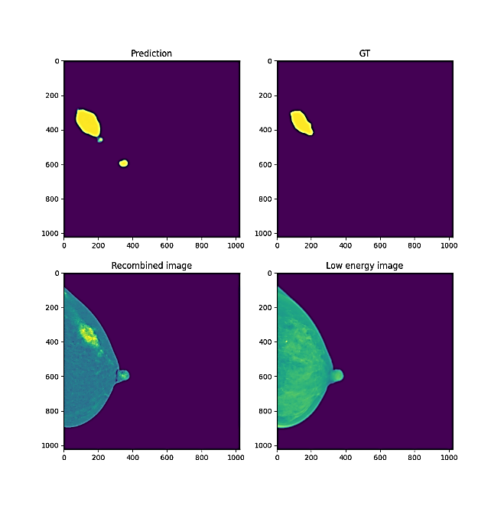

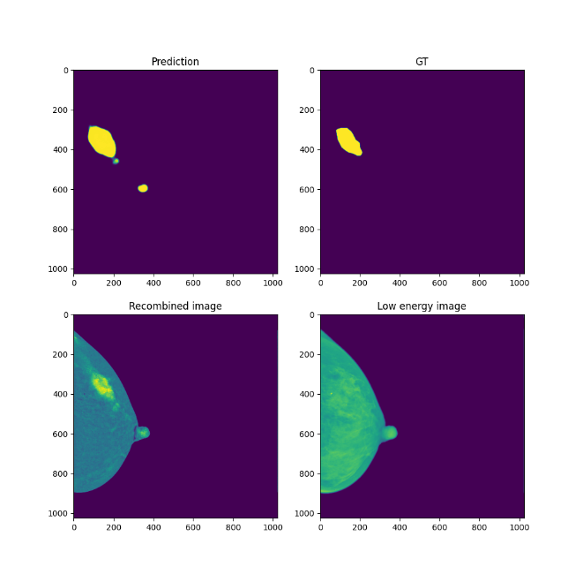
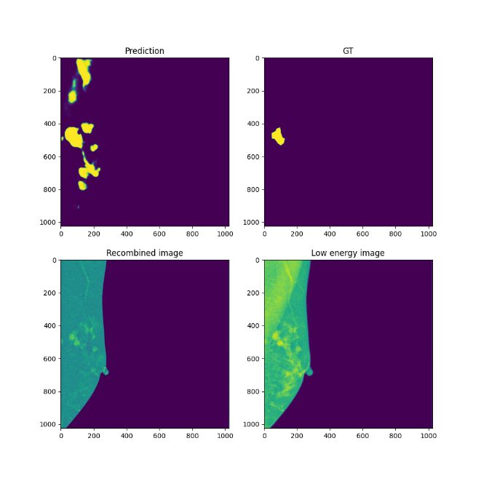
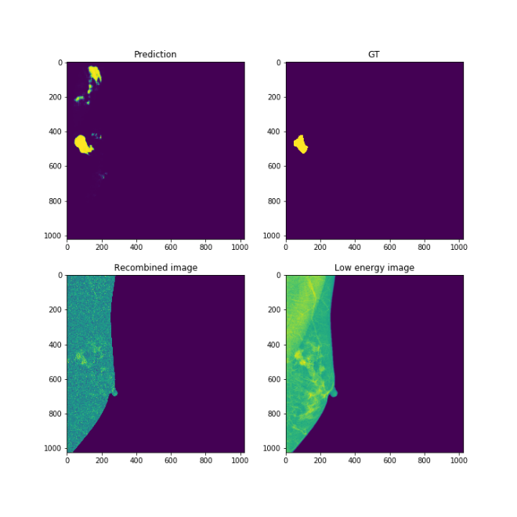
Results – data augmentation methods
Standard DA
Realistic DA
Ground truth

Slide 15
Conclusions
Conclusions:
Data-augmentations based on realistic transformations improve performances of the segmentation network, especially on small datasets
The augmentation model can be obtained from very small datasets
The realistic transformation model does not require hyperparameter to tune
It provides augmentation without bias
This augmentation technique could easily be coupled with other augmentation techniques (eg, GAN, VAE, etc.)

Slide 16
Thank you for your attention!
Data augmentation for breast mass segmentation
Luc Caselles
Clément Jailin
Serge Muller

